Slide 1
My SQL Project
Results from individual queries

Slide 2
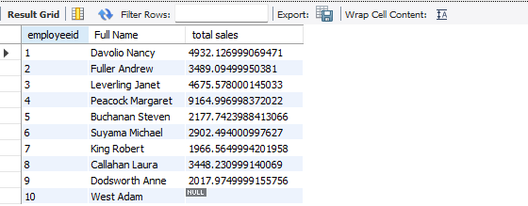
Result 1

Slide 3

Result 2

Slide 4

Result 3

Slide 5

Result 5

Slide 6

Result 6

Slide 7
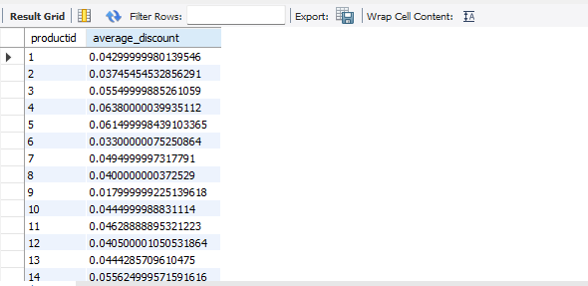
Result 7

Slide 8
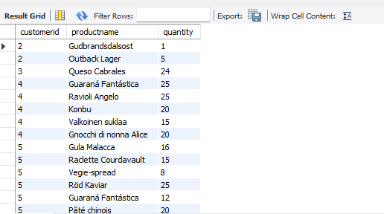
Result 8

Slide 9
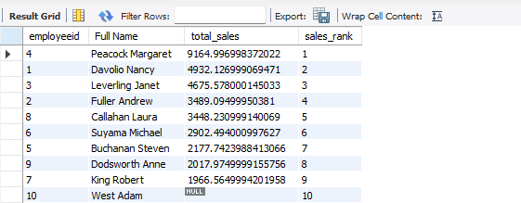
Result 9

Slide 10
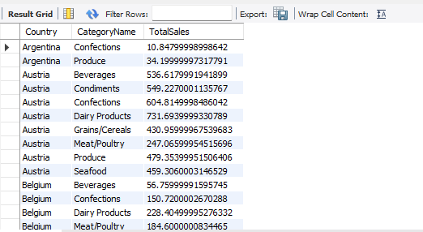
Result 10

Slide 11
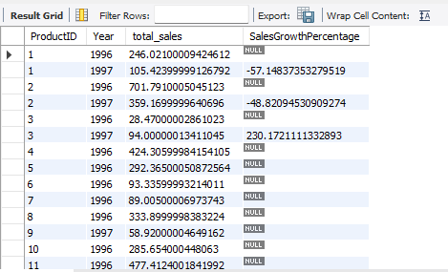
Result 11

Slide 12
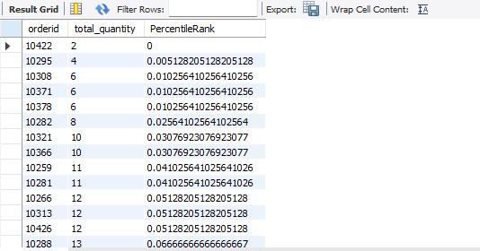
Result 12

Slide 13

Result 13

Slide 14
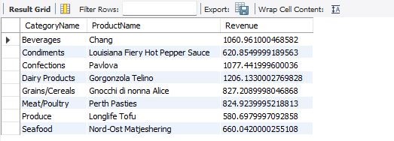
Result 14

Slide 15
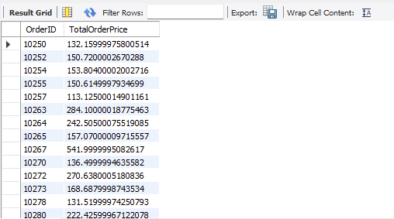
Result 15

